Slide 1
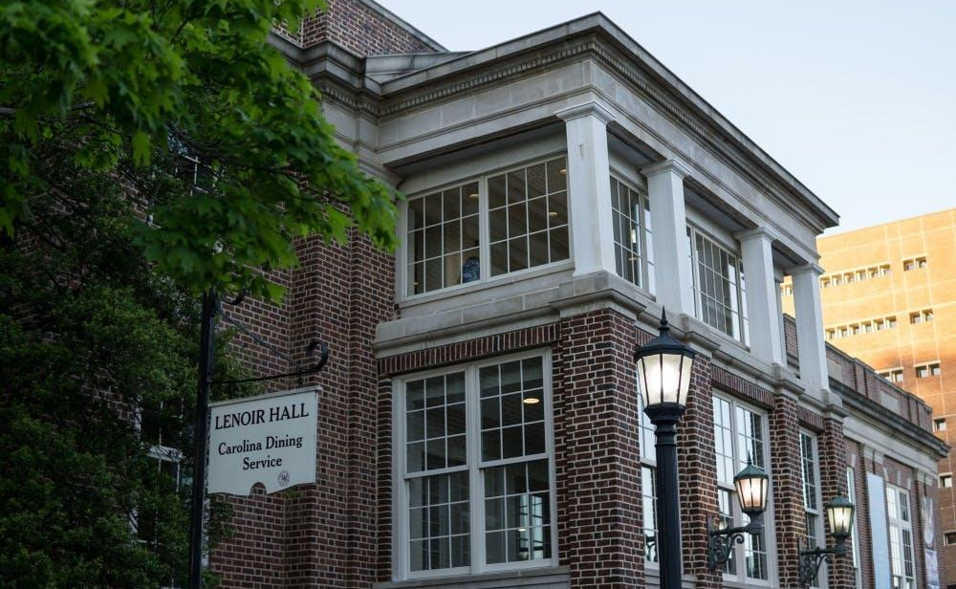
On-Campus Dining Frequency
and Vegetable Consumption Among UNC Undergraduate Students
04.21.26
Audrija Bhattacharya, Mackenzie Connaughton, Isabella Larson, Riley Logan
Epid 600

Slide 2
Agenda
Epid 600
1.
Introduction
2.
Methods
3.
Results
4.
Discussion

Slide 3


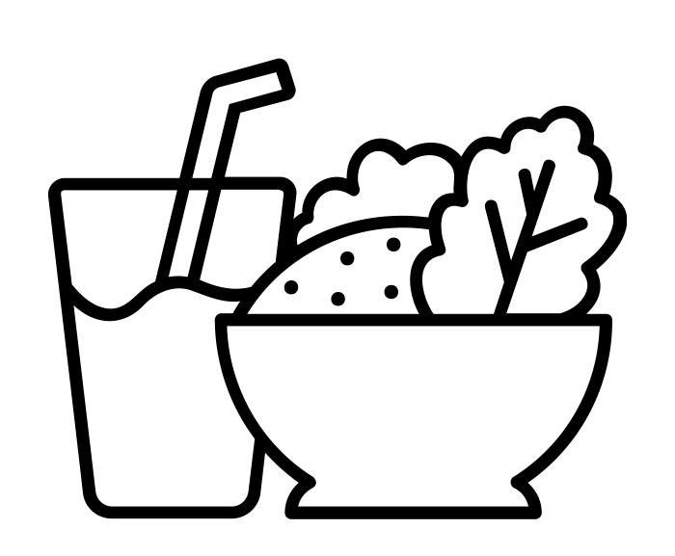

Introduction
Epid 600
Study Overview & Importance
We surveyed UNC undergraduates to examine whether eating at campus dining halls is associated with adequate vegetable consumption
Low fiber intake in young people is linked to rising rates of colon cancer
Vegetables are a primary source of dietary fiber
College is a critical window for establishing long-term dietary habits
UNC dining halls directly shape what thousands of students eat daily

Slide 4
Introduction
Epid 600
Study Design & Hypothesis
Study Design
Hypothesis
Cross-sectional survey of UNC Undergraduate students
Exposure: Eating at UNC dining halls ≥ 5 meals/week in the past 7 days
Outcome: Adequate vegetable consumption of
≥ 7 portions/week) in the past 7 days
Tested Confounders: Gender, financial barriers to food access, feelings about vegetables
UNC undergraduates who eat on campus ≥ 5 meals/week have different vegetable consumption levels than those
who do not.

Slide 5
Agenda
Epid 600
1.
Introduction
2.
Methods
3.
Results
4.
Discussion

Slide 6
Methods
Epid 600
Study Sample, Cleaning, & Tests Used
Study Sample
Response Rate
UNC undergraduate students recruited via convenience sampling
N = 84
Surveys distributed via email, GroupMe, Instagram, text message, and word of mouth
84 completed responses / 2,303 individuals in sampling frame = 3.6% responded
Data Cleaning
Tests Used
18 incomplete responses excluded, no data errors found
N = 102 - 18 =
84 complete responses
Crude & stratified ORs to assess confounding and EMM
Logistic regression with percent-change method (≥10% threshold)
FInal logistic regression model adjusted for confounders after assessment

Slide 7
Methods
Epid 600
Recoding
Exposure
All participants that ate on-campus 5+ times a week were deemed exposed (1), while those that did not were deemed unexposed (0)
Outcome
All participants that ate 7+ palm-sized portions a week were considered to have the outcome (1), while those that did not were considered to not have the outcome (0)
Confounders
For gender stratification, we lumped male into one group (0) and female into another group (1). We dropped Non-Binary/other stratification due to the small sample size. For food insecurity, we combined everyone who didn’t experience it (0) vs those who did (1). Finally, for vegetable feeling stratification, we compared everyone that was content with their vegetable consumption to those that wish they ate more.

Slide 8
Methods
Year in School
Epid 600
DAG
Meal Plan Possession
Feelings about Vegetables
Distance Barriers to Food
Financial Barriers to Food Access
Frequency of Restaurant Patronage
Frequency of Dining Hall Consumption
Frequency of Vegetable Consumption
Gender
Frequency of Delivery Service Usage
Frequency of Home Cooking

Slide 9
Methods
Epid 600
Confounders and EMMs
Gender (Confounder)
Women are more likely to cook than men at the educational level of “some college”, which may result in a gender imbalance in dining hall attendance.
Women have stronger knowledge and belief in dietary guidelines. Students reported that their individual knowledge of dietary guidelines impacted their food choices. This shows how gender impacts vegetable consumption.
Financial Barriers to Food Access (Confounder)
The cost of one meal at a dining hall at UNC can be > 15 dollars, and meal plans at UNC can cost up to $3,398.53 per semester.
Cost influences student food choices heavily, deterring low SES students from relying on the dining hall as a food source. Groups with higher socioeconomic status are more likely to consume fruits or vegetables.⁸
Feelings About Vegetable Consumption (EMM)
At the university level, students reported that their individual knowledge of dietary guidelines impacted their food choices, with one reporting that they “...don’t like vegetables, but I know that I need it and that’s why I eat vegetables”

Slide 10
Agenda
Epid 600
1.
Introduction
2.
Methods
3.
Results
4.
Discussion

Slide 11
Results
Epid 600
Descriptive Statistics
Table 1. Prevalence of Campus Dining Frequency, Vegetable Consumption, and Key Potential Confounding Variables in UNC Students (n = 84)
Variable | Response | N (%) (or Mean ± SD)
Exposure (Eating on Campus) | Infrequent eating on campus (≤5 time/week) | 72 (85.71%)
 | Frequent eating on campus (≥5 times/week) | 12 (14.29%)
Outcome (Adequate Vegetable Consumption, ≥ 7 portions/week) | Yes | 34 (40.48%)
 | No | 50 (59.52%)
Covariate (Gender) | Male | 27 (32.14%)
 | Female | 49 (58.33%)
 | Non-binary/Third gender | 8 (9.52%)
Financial Barriers to Food Access | Experiences Financial Insecurity | 11 (13.10%)
 | Does not Experience Financial Insecurity | 73 (86.90%)
Feelings about Vegetable Consumption | Content with Vegetable Consumption Levels | 36 (42.86%)
 | Wish Vegetable Consumption Levels were Higher | 48 (57.14%)

Slide 12
Results
Epid 600
Interpretations
Exposure Prevalence
Low prevalence of eating on campus
14.29% ate on campus ≥ 5 times weekly
Outcome Prevalence
Split prevalence of adequate vegetable consumption
40.48% consumed vegetables ≥ 7 times weekly, while 59.52% did not.
Covariate Prevalence
Split prevalence on feelings about vegetable consumption (42.9% content, 57.1% not)
Low prevalence of financial barriers to food insecurity (13.1%)
Reached more females than males (58.3% female)

Slide 13
Results
Epid 600
Confounding Assessment Gender
Estimate | Odds Ratio | 95% CI
Crude (n = 84) | 2.33 | (0.57, 10.21)
Stratified (Male Only, n = 27) | 1.93 | (0.13, 112.31)
Stratified (Female Only, n = 49) | 2.11 | (0.26, 14.56)
Regression Adjusted | 2.42 | (0.67, 8.77)
When stratified by gender, the Odds Ratio point estimate of both groups were lower than the crude, which suggests the presence of confounding. However, all 95% confidence intervals contain the null value of 1, making this statistically insignificant. In addition, the roughly 3% change between the crude and regression adjusted values was below the 10% threshold, meaning there is little evidence of confounding.

Slide 14
Results
Epid 600
Confounding Assessment Financial Insecurity
Estimate | Odds Ratio | 95% CI
Crude (n = 84) | 2.33 | (0.57, 10.21)
Stratified (Experiences Financial Insecurity, n = 11) | 3.50 | (0.03, 313.10)
Stratified (Does not Experience Financial Insecurity, n = 73) | 2.28 | (0.48, 12.01)
Regression Adjusted | 2.44 | (0.69, 8.58)
When stratifying by financial insecurity, the stratified groups Odds Ratio point estimates were on either side of the crude value, but nearby. This suggests potential EMM, but is not strong evidence. All 95% confidence intervals contain the null value of 1, indicating statistical insignificance. The percent change for the regression adjusted OR was less than 10% and not suggestive of a confounding variable.

Slide 15
Results
Epid 600
Confounding Assessment Feelings About Vegetables (EMM)
Estimate | Odds Ratio | 95% CI
Crude (n = 84) | 2.33 | (0.57, 10.21)
Stratified (Content with Vegetable Consumption Levels, n = 36) | 2.89 | (0.24, 153.01)
Stratified (Wish Vegetable Consumption Levels were Higher, n = 48) | 2.67 | (0.32, 18.76)
Regression adjusted | 2.74 | (0.71, 10.53)
When stratifying by vegetable feelings, both groups had higher Odds Ratio point estimates than the crude Odds Ratio and were very close in value, which suggests potential confounding for this variable. Again, all 95% confidence intervals contained the null value of 1, making these results statistically insignificant. Additionally, the percent change in the regression adjusted OR was greater than 10% giving more suggestion that feelings about vegetables may be a confounder.

Slide 16
Agenda
Epid 600
1.
Introduction
2.
Methods
3.
Results
4.
Discussion

Slide 17
Discussion
Epid 600
Main Findings
Outcome Prevalence
Exposure-
Outcome Association
Comparison to Existing Literature
Statistical Significance
Our study reported over 15 percentage points lower prevalence of vegetable consumption than other studies regarding college diets.
(Potential selection bias)
It is worth noting, however, that all of our OR, crude, stratified, and adjusted, contained the null value of 1, and therefore statistically insignificant.
Students who ate on campus 5+ times a week were 2.33 times as likely to eat 7+ vegetables a week than those that did not eat on campus 5+ times a week.
This is in line with a study at GWU that found freshman ate 0.8 more servings of vegetables on average when eating at their campus dining than when eating elsewhere.

Slide 18
Discussion
Epid 600
Strengths
Social Desirability Bias
Internal Validity
Social desirability bias was reduced through anonymous survey design
Multiple food sources were accounted for beyond dining halls, strengthening internal validity
Measurement Accuracy
Confounding Bias
Survey instrument pilot tested and revised based on feedback
Confounders were identified and controlled for, reducing confounding bias

Slide 19
Discussion
Epid 600
Weaknesses
Selection Bias
Sampling Bias
Low response rate (3.6%) may introduce selection bias
Convenience sampling overrepresents juniors and seniors, limiting generalizability
Small sample size limits generalizability
Confounding
Information Bias
Residual confounding from unmeasured variables possible
Cross-sectional design makes it difficult to establish temporality
Self-reported vegetable intake subject to non-differential misclassification, biasing toward the null
Recall bias may have inflated vegetable consumption prevalence

Slide 20
Discussion
Epid 600
Conclusion
Public Health Significance
Study Conclusion
Recommendations
Dietary decisions starting in college follow into adulthood, so being able to identify modifiable factors such as dining hall activity that shape vegetable consumption is meaningful for long-term health.
This study found a positive, albeit statistically insignificant, positive association between eating on campus and eating vegetables regularly. Further studies with larger sample sizes are warranted to confirm.
Our study suggests that the dining halls could cause students to eat more vegetables. Lowering barriers to meal plans by making it cheaper, or offering delivery options for off-campus students is the next step for increasing UNC students’ vegetable consumption.

Slide 21
Conclusion
EPID 600
Thank you!
Questions?

Slide 22
Conclusion
Epid 600
References
Song M, Garrett WS, Chan AT. 2015. Nutrients, Foods, and Colorectal Cancer Prevention. Gastroenterology. 148(6):1244-1260.e16. https://doi.org/10.1053/j.gastro.2014.12.035
Slavin JL, Lloyd B. 2012. Health benefits of fruits and vegetables. Adv Nutr. 3(4):506–516. https://doi.org/10.3945/an.112.002154
Li X, Braakhuis A, Li Z, Roy R. 2022 Apr. How Does the University Food Environment Impact Student Dietary Behaviors? A Systematic Review. [accessed 2026 Feb 6]. https://pubmed.ncbi.nlm.nih.gov/35571951/.
Taillie LS. Who’s cooking? Trends in US home food preparation by gender, education, and race/ethnicity from 2003 to 2016. Nutr J. 2018;17(1):41. doi:10.1186/s12937-018-0347-9
Wardle J, Haase AM, Steptoe A, Nillapun M, Jonwutiwes K, Bellisle F. Gender differences in food choice: the contribution of health beliefs and dieting. Ann Behav Med. 2004;27(2):107-116. doi:10.1207/s15324796abm2702_5
Deliens T, Clarys P, De Bourdeaudhuij I, Deforche B. Determinants of eating behaviour in university students: a qualitative study using focus group discussions. BMC Public Health. 2014;14:53. Published 2014 Jan 18. doi:10.1186/1471-2458-14-53
University of North Carolina at Chapel Hill Dining Services. Meal plans. Accessed April 21, 2026. UNC Meal Plans
Darmon N, Drewnowski A. Does social class predict diet quality?. Am J Clin Nutr. 2008;87(5):1107-1117. doi:10.1093/ajcn/87.5.1107
Ellis JM, Galloway AT, Zickgraf HF, Whited MC. 2018. Picky eating and fruit and vegetable consumption in college students. Eating Behaviors. 30:5–8. doi:10.1016/j.eatbeh.2018.05.001.
Vivekanandan N, Vallone N, Sylvetsky A. Impact of University Dining Hall on Fruit and Vegetable Consumption among First-year Undergraduate Students.

Slide 23
Conclusion
EPID 600
AI Attestation
We attest that this submission did not use AI in its development or in the creation of any of its components.

